Slide 1
Closure Properties of Context-free Languages
V.Vijayarajan
Assistant Professor
SCSE, VIT University
Vellore

Slide 2
Positive Properties of
Context-Free languages
1

Slide 3



Union
Context-free languages
are closed under:
Union
is context free
is context free
is context-free

Slide 4
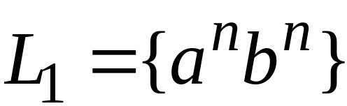
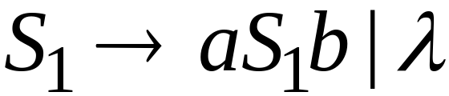
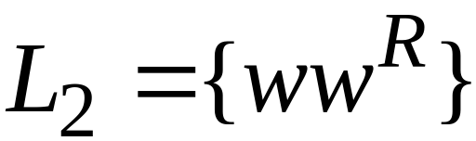
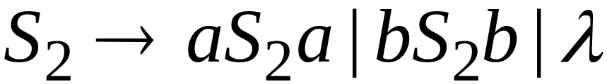
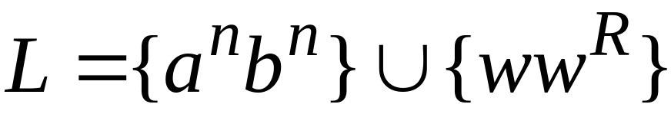

Example
Language
Grammar
Union

Slide 5
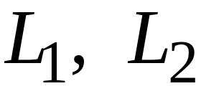
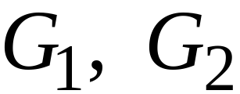
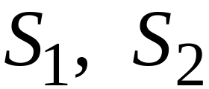

In general:
For context-free languages
with context-free grammars
and start variables
The grammar of the union
has new start variable
and additional production

Slide 6

Concatenation
Context-free languages
are closed under:
Concatenation
is context free
is context free
is context-free

Slide 7
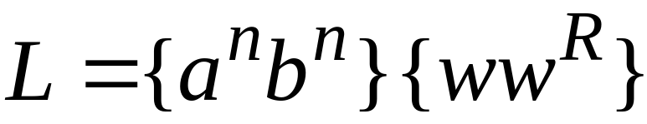
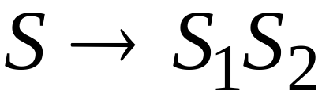
Example
Language
Grammar
Concatenation

Slide 8
In general:
For context-free languages
with context-free grammars
and start variables
The grammar of the concatenation
has new start variable
and additional production

Slide 9


Star Operation
Context-free languages
are closed under:
Star-operation
is context free
is context-free

Slide 10
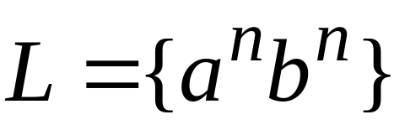
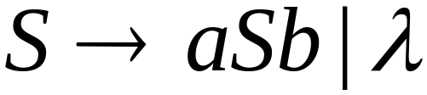
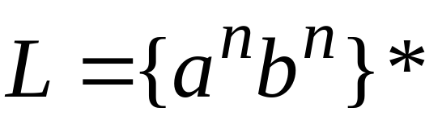
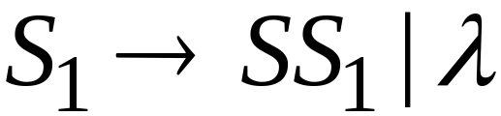
Example
Language
Grammar
Star Operation

Slide 11



In general:
For context-free language
with context-free grammar
and start variable
The grammar of the star operation
has new start variable
and additional production

Slide 12
Negative Properties of
Context-Free Languages

Slide 13

Intersection
Context-free languages
are not closed under:
intersection
is context free
is context free
not necessarily
context-free

Slide 14
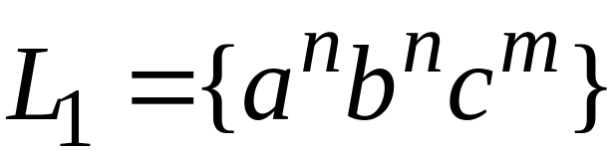
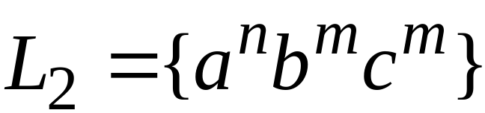
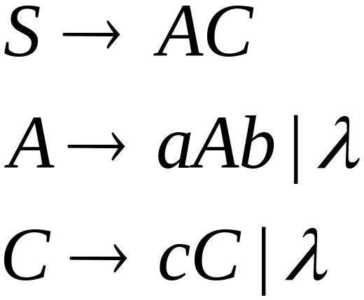
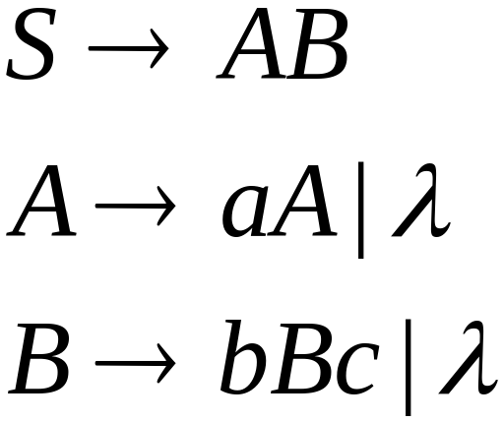
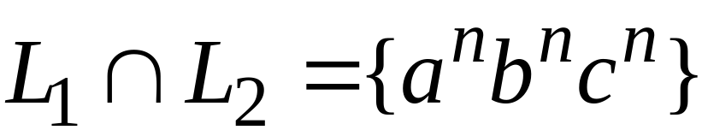
Example
Context-free:
Context-free:
Intersection
NOT context-free

Slide 15

Complement
Context-free languages
are not closed under:
complement
is context free
not necessarily
context-free

Slide 16
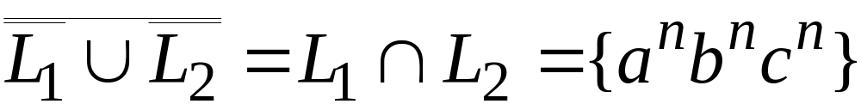
Example
Context-free:
Context-free:
Complement
NOT context-free

Slide 17
Intersection of
Context-free languages and
Regular Languages

Slide 18
The intersection of
a context-free language and
a regular language
is a context-free language
context free
regular
context-free

Slide 19



Machine
Machine
NPDA
for
DFA
for
context-free
regular
Construct a new NPDA machine
that accepts
simulates in parallel and

Slide 20
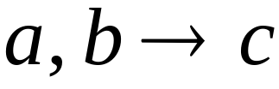




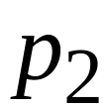
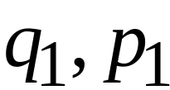
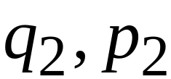
NPDA
DFA
transition
transition
NPDA
transition

Slide 21


NPDA
DFA
transition
NPDA
transition

Slide 22

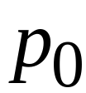
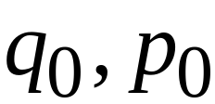
NPDA
DFA
initial state
initial state
NPDA
Initial state

Slide 23
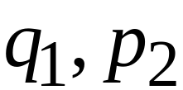
NPDA
DFA
final state
final states
NPDA
final states

Slide 24
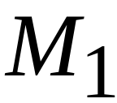









Example:
context-free
NPDA

Slide 25
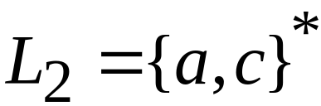
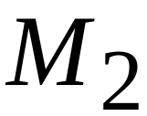


regular
DFA

Slide 26
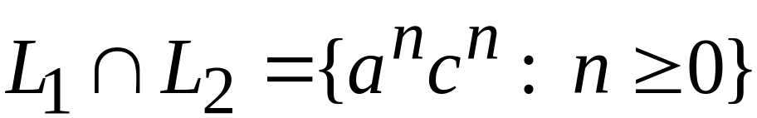





context-free
Automaton for:
NPDA

Slide 27


In General:
simulates in parallel and
accepts string
if and only if
accepts string and
accepts string

Slide 28
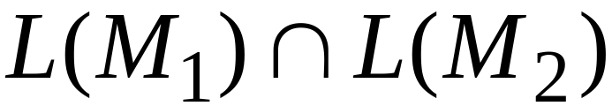
Therefore:
is NPDA
is context-free
is context-free

Slide 29
Applications of
Regular Closure

Slide 30
The intersection of
a context-free language and
a regular language
is a context-free language
Regular Closure
context free
regular
context-free

Slide 31
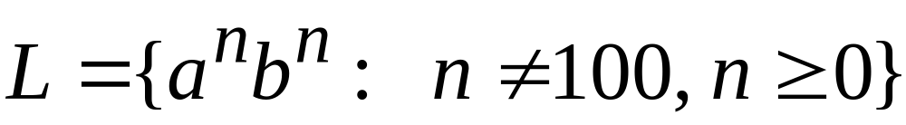
An Application of Regular Closure
Prove that:
is context-free

Slide 32

We know:
is context-free

Slide 33
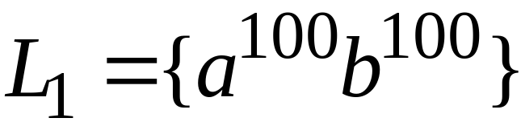
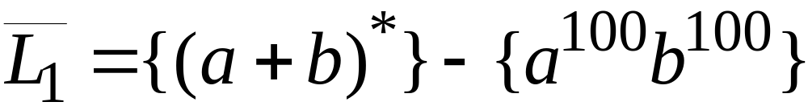
We also know:
is regular
is regular

Slide 34
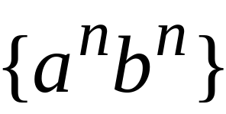
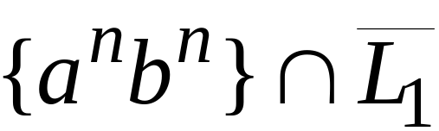
context-free
regular
(regular closure)
context-free
is context-free

Slide 35
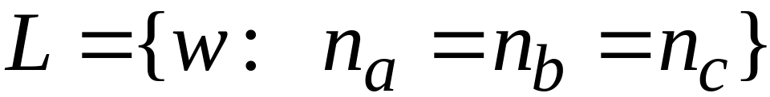
Another Application of Regular Closure
Prove that:
is not context-free

Slide 36
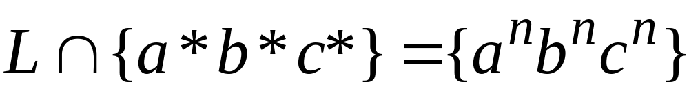
If
is context-free
(regular closure)
Then
context-free
regular
context-free
Impossible!!!
Therefore, is not context free

Slide 37
Decidable Properties of
Context-Free Languages

Slide 38

Membership Question:
for context-free grammar
find if string
Membership Algorithms:
Parsers
Exhaustive search parser
CYK parsing algorithm

Slide 39
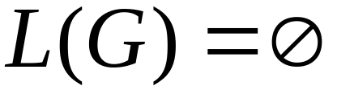
Empty Language Question:
for context-free grammar
find if
Algorithm:
Remove useless variables
Check if start variable is useless

Slide 40
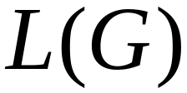

Infinite Language Question:
for context-free grammar
find if is infinite
Algorithm:
1. Remove useless variables
2. Remove unit and productions
3. Create dependency graph for variables
4. If there is a loop in the dependency graph
then the language is infinite

Slide 41
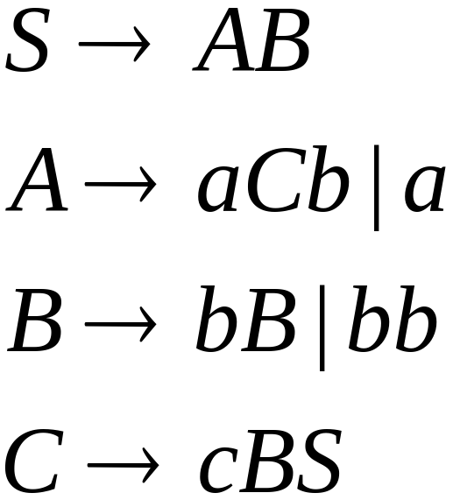




Example:
Infinite language
Dependency graph

Slide 42
